Slide 1
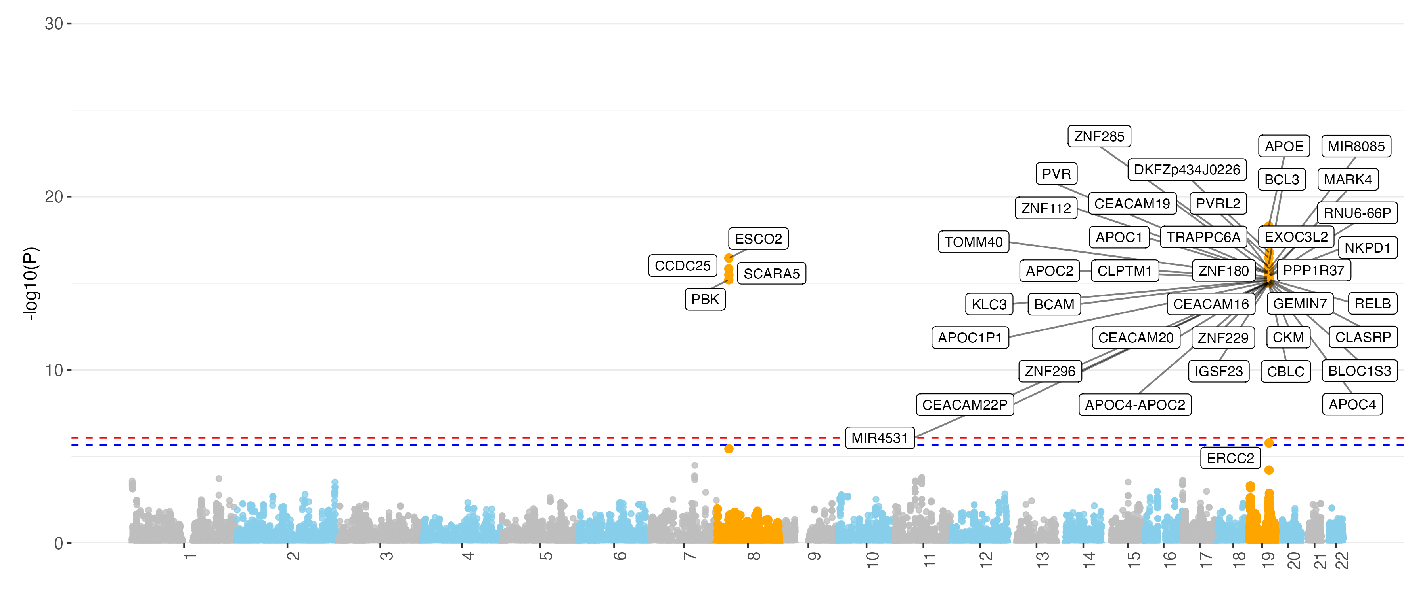
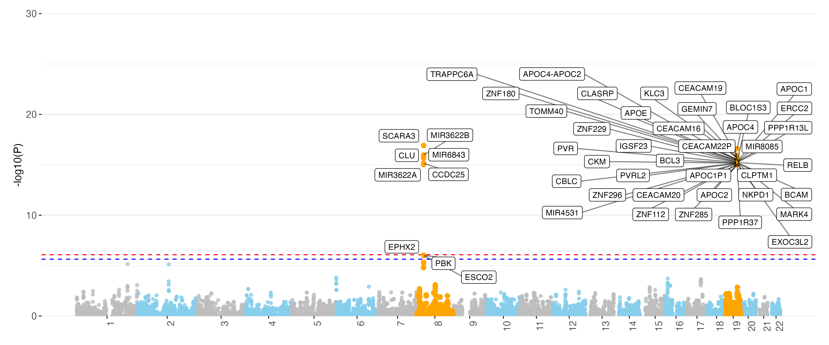
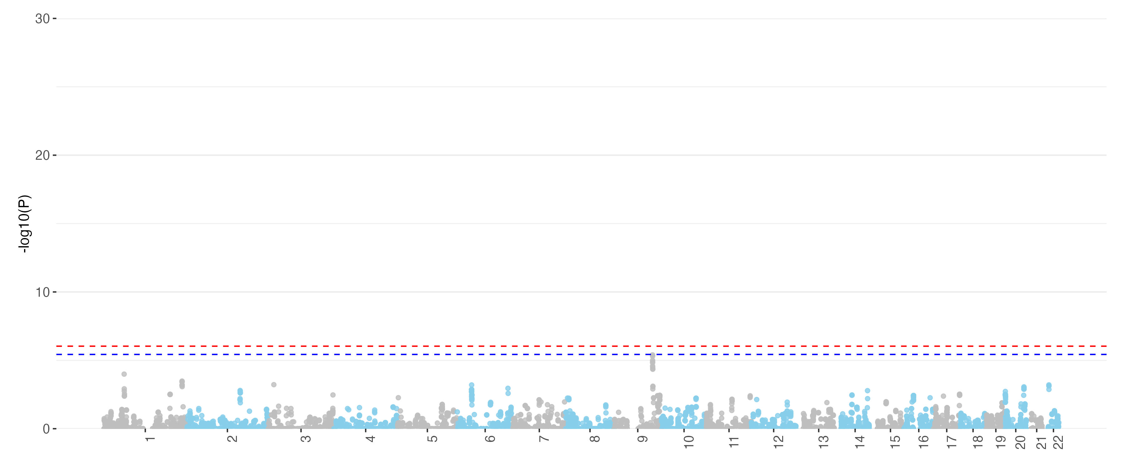
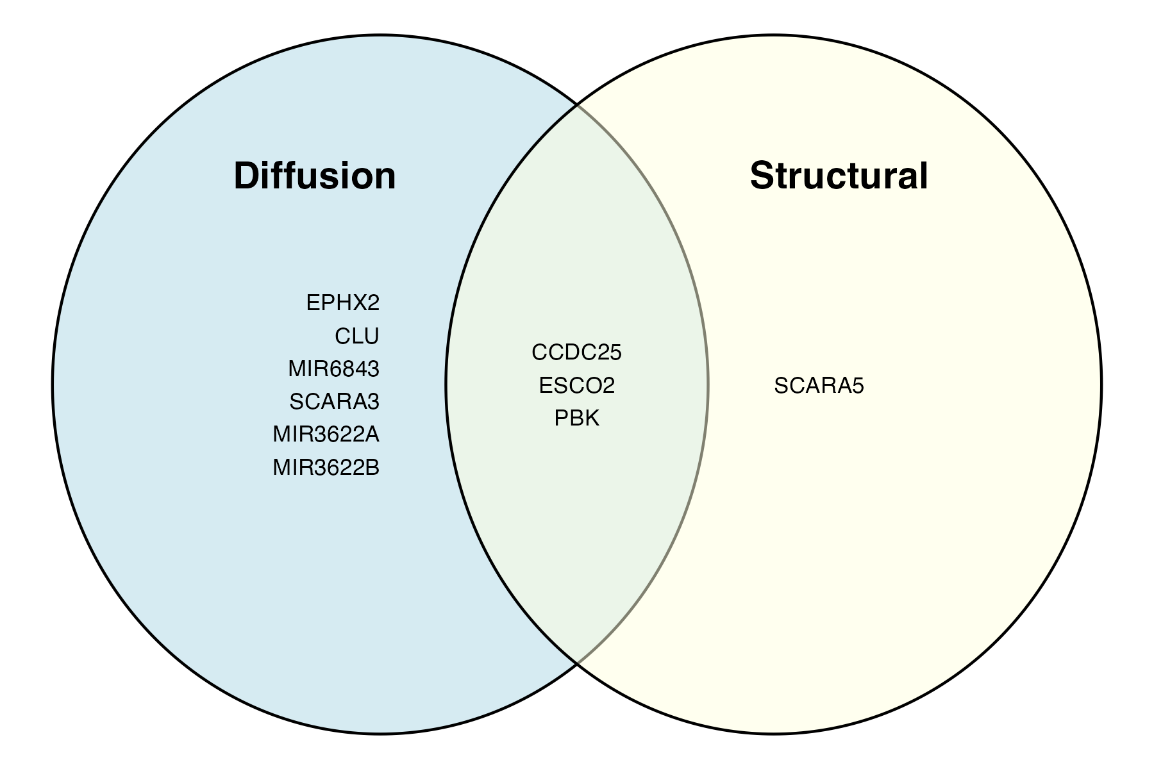
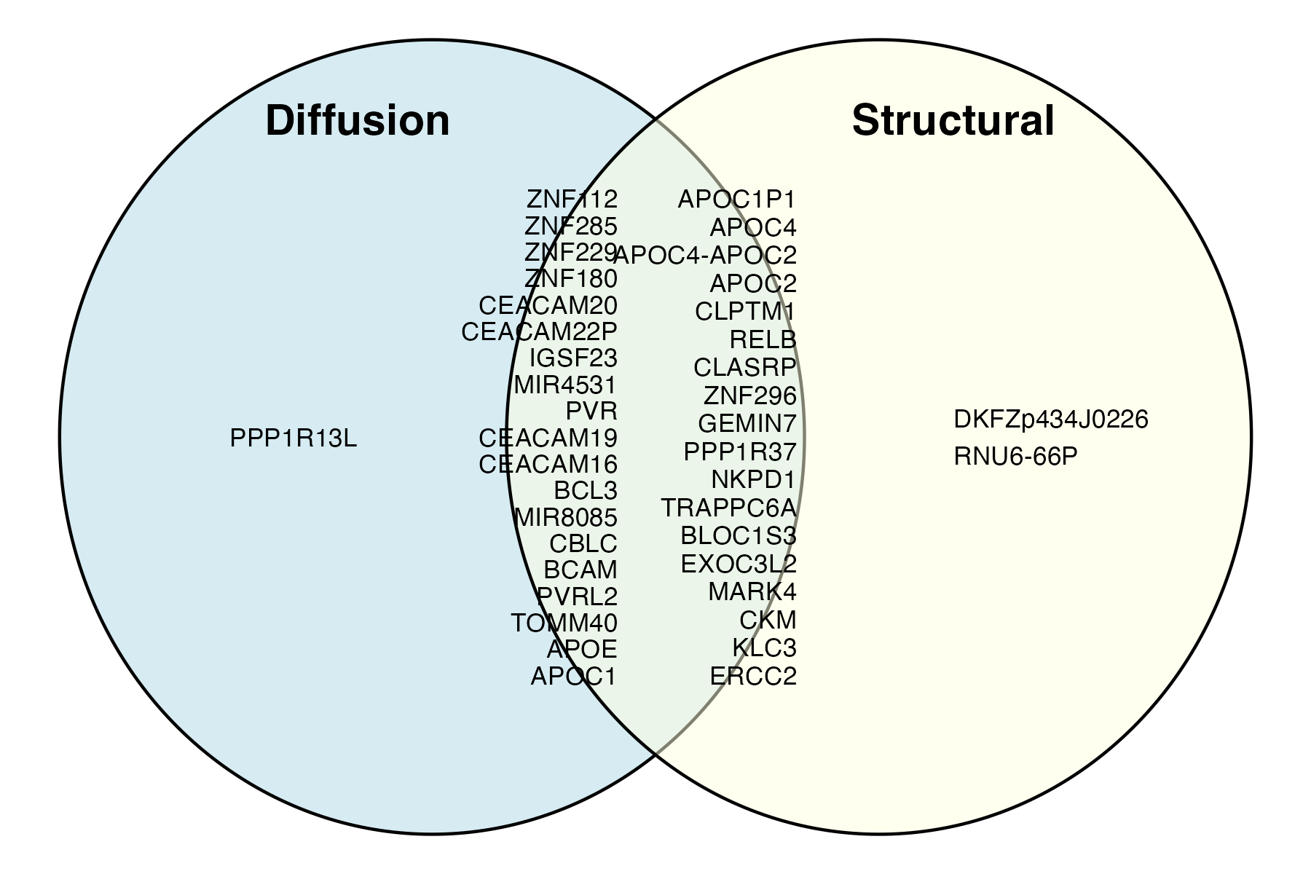
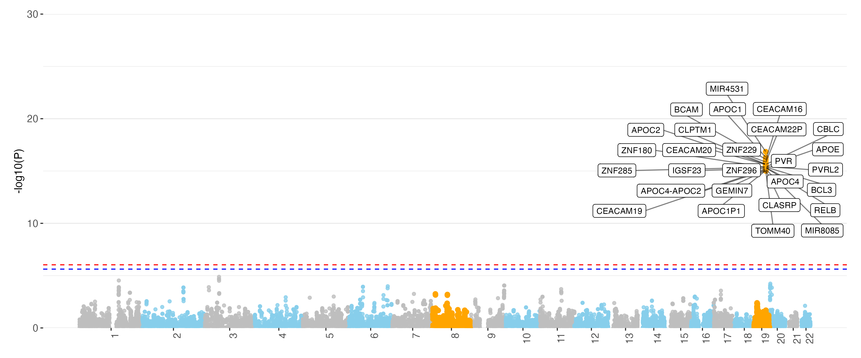
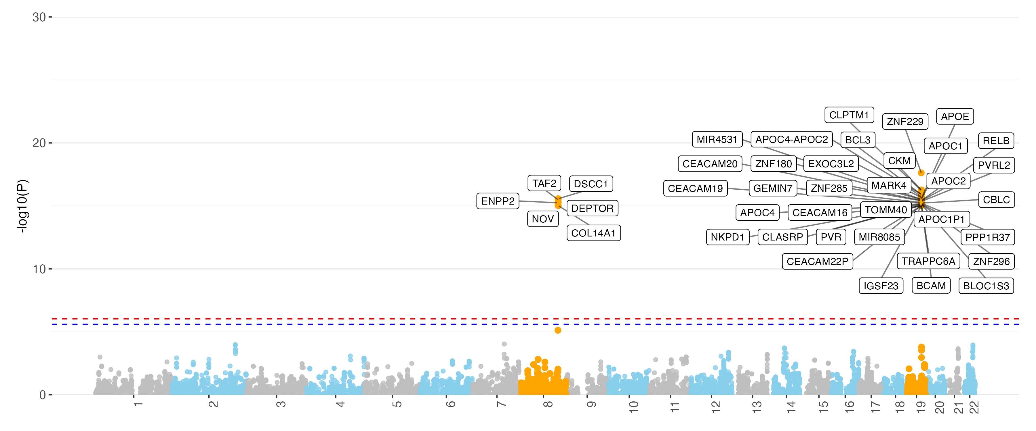
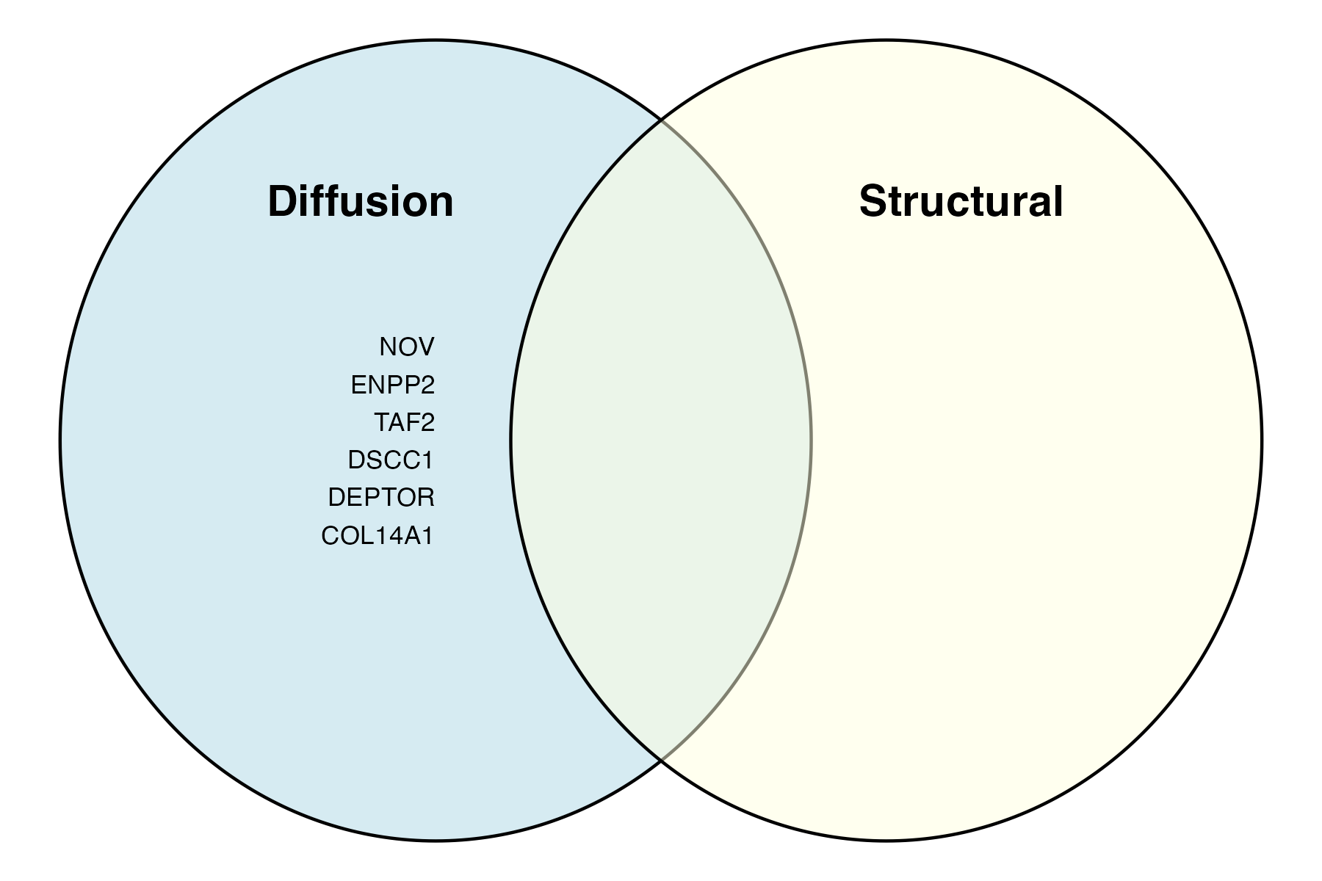
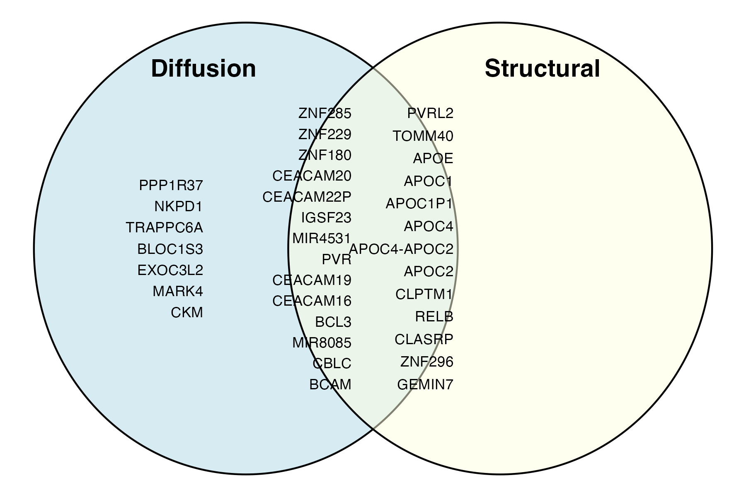
A. IGAP Structural MRI | other modalities
B. IGAP Diffusion MRI | other modalities
C. IGAP Functional MRI | other modalities
D. IGAP
Chr 8
Chr 19
E. UKB Structural MRI | other modalities
F. UKB Diffusion MRI | other modalities
G. UKB Functional MRI | other modalities
H. UKB
Chr 8
Chr 19
Notes:
IGAP UKB VC

